Slide 1
Network Compression
Hung-yi Lee 李宏毅
Notes:
Edge computing
===
這張表格列出了一些edge device的記憶體大小，雖然該記憶體大小不完全等於可以運行的模型大小，但我認為可以作為大致的upperbound。一般的edge device如果有AI accelerator，通常會把當下沒要用到（例如其他layer的parameter）且on-chip memory存不下的資料暫時放到off-chip memory, on-chip memory通常都比off-chip小得多，on-chip memory通常應該頂多就幾MB到幾十MB，模型如果比off-chip memory大的話基本上等於不能跑

Slide 2
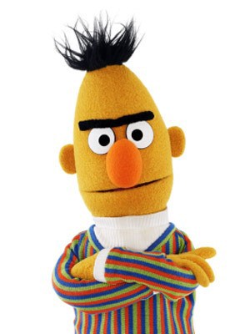

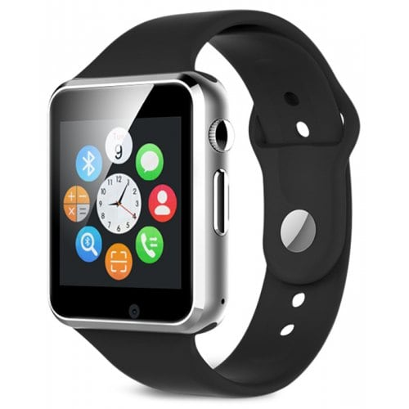
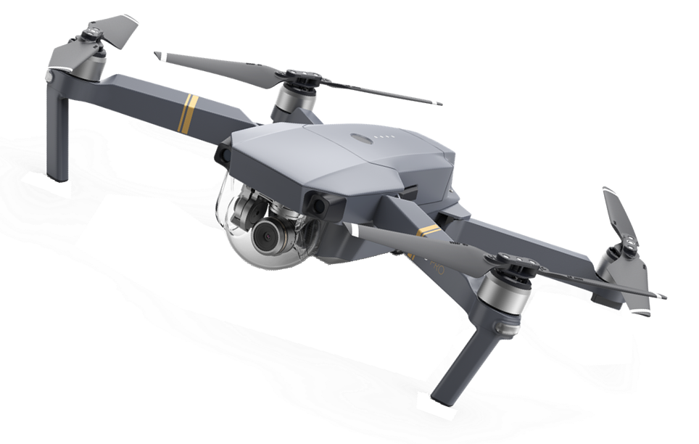
Smaller Model
Less parameters
Deploying ML models in resource-constrained environments
Lower latency, Privacy, etc.
Notes:
Limited memory space, limited computing power, etc.

Slide 3
Outline
Network Pruning
Knowledge Distillation
Parameter Quantization
Architecture Design
Dynamic Computation
We will not talk about hard-ware solution today.

Slide 4
Network Pruning
Notes:
裡面用來 weight 不同的參數是用 Fisher information，我剛剛用 fisher information 跟 network pruning 做關鍵字搜尋，找到以下兩篇(可能還有更多，我沒有仔細看)：
https://arxiv.org/abs/1906.10771
https://arxiv.org/abs/1801.05787
這兩篇文章 pruning 的方式都跟 fisher information 有關。
我知道的敘述多來自成翰第一篇文章內提到的reference，有五篇根據sparsity考量的，我沒有細看，我這邊列出三篇 不過我是根據那篇內文看到的: https://arxiv.org/pdf/1802.00124.pdf, https://arxiv.org/pdf/1707.01213.pdf, https://arxiv.org/pdf/1608.08710.pdf。
=======
How to prune?????
Predicting Parameters in Deep Learning

Slide 5
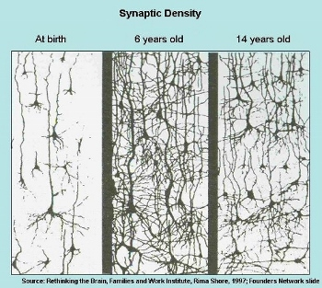
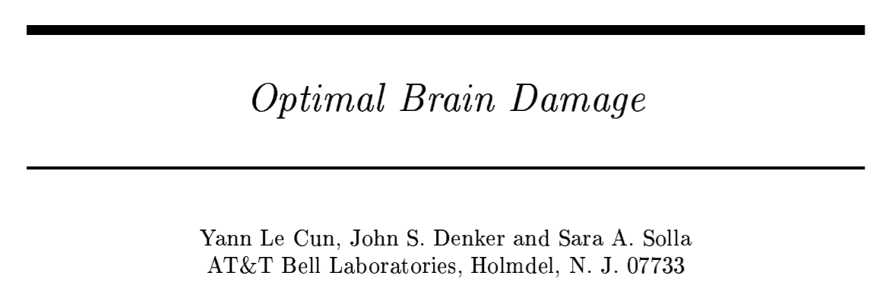
Network can be pruned
Networks are typically over-parameterized (there is significant redundant weights or neurons)
Prune them!
(NIPS, 1989)

Slide 6
Network Pruning
Pre-trained
Network
Importance of a weight:
large
absolute values, life long …
Evaluate the Importance
Importance of a neuron:
the number of times it wasn’t zero on a given data set ……
Remove
After pruning, the accuracy will drop (hopefully not too much)
smaller
Fine-tune
Fine-tuning on training data for recover
Small enough?
Don’t prune too much at once, or the network won’t recover.
Smaller Network
Notes:
Pruning neural networks is an old idea going back to 1990 (with Yan Lecun’s optimal brain damage work) and before. The idea is that among the many parameters in the network, some are redundant and don’t contribute a lot to the output.
If you could rank the neurons in the network according to how much they contribute, you could then remove the low ranking neurons from the network, resulting in a smaller and faster network.
Getting faster/smaller networks is important for running these deep learning networks on mobile devices.
The ranking can be done according to the L1/L2 mean of neuron weights, their mean activations, the number of times a neuron wasn’t zero on some validation set, and other creative methods . After the pruning, the accuracy will drop (hopefully not too much if the ranking clever), and the network is usually trained more to recover.
If we prune too much at once, the network might be damaged so much it won’t be able to recover.
So in practice this is an iterative process - often called ‘Iterative Pruning’: Prune / Train / Repeat.

Slide 7
Network Pruning - Practical Issue
Weight pruning
The network architecture becomes irregular.
Prune some weights
0
Hard to implement, hard to speedup ……
Notes:
Hard to implement ... Can you implement by keras
Even you can implement
It is hard to speedup by GPU
Actually, use zero to replace -> just 自ｈｉ in paper
We will evaluate model size …..

Slide 8
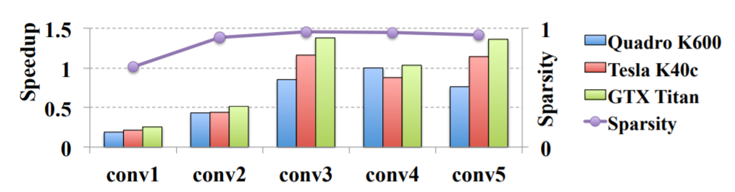
Network Pruning - Practical Issue
Weight pruning
https://arxiv.org/pdf/1608.03665.pdf
Notes:
nVIDIA Quadro K600 12GB 3D 繪圖卡
原廠三年保NVIDIA TESLA K40 12GB GPU K40 / K 40 CUDA 平行運算 ...

Slide 9
Network Pruning - Practical Issue
Neuron pruning
The network architecture is regular.
Prune some neurons
Easy to implement, easy to speedup ……
Notes:
Hard to implement ... Can you implement by keras
Even you can implement
It is hard to speedup by GPU
Actually, use zero to replace -> just 自ｈｉ in paper
We will evaluate model size …..

Slide 10

Why Pruning?
How about simply train a smaller network?
It is widely known that smaller network is more difficult to learn successfully.
Larger network is easier to optimize? https://www.youtube.com/watch?v=_VuWvQUMQVk
Lottery Ticket Hypothesis
https://arxiv.org/abs/1803.03635
Notes:
The Lottery Ticket Hypothesis: Finding Small, Trainable Neural Networks???
It was proposed in 2018 by Jonathan Frankle, a PhD student at MIT, and Michael Carbin, a professor at MIT.

Slide 11
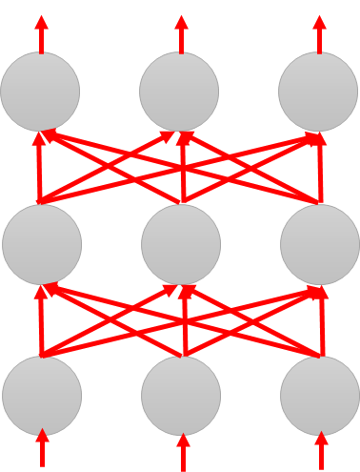
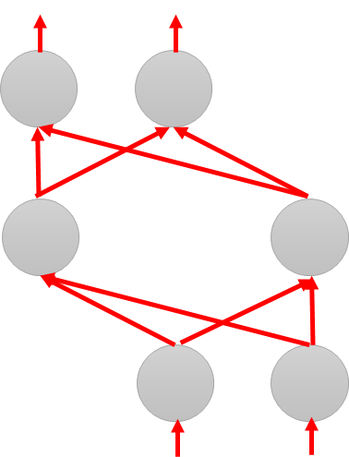
Why Pruning?
Lottery Ticket Hypothesis
Large Network
Train
Large Network
Win!
Train
Sub-
network
Sub-
network
Win!
Sub-
network
Train
Sub-
network
……
……

Slide 12

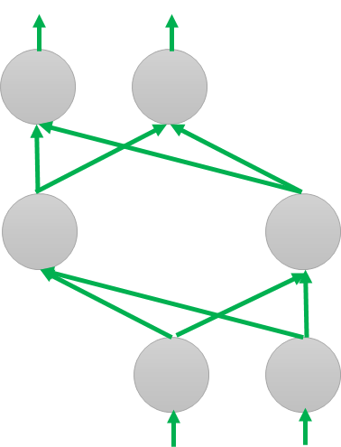
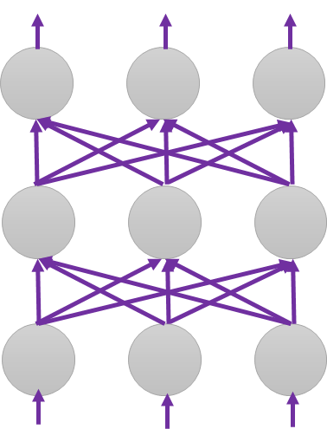
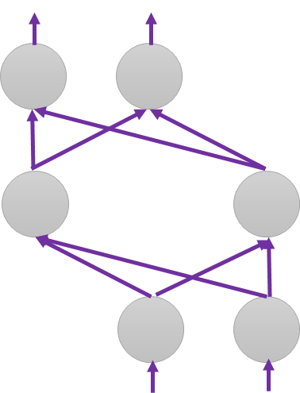

Why Pruning?
Lottery Ticket Hypothesis
Random init
Again
Original
Random init
Random init
Trained
Pruned
Random Init weights
Trained weight
Another random Init weights
Notes:
https://www.plurk.com/p/n27r0g

Slide 13
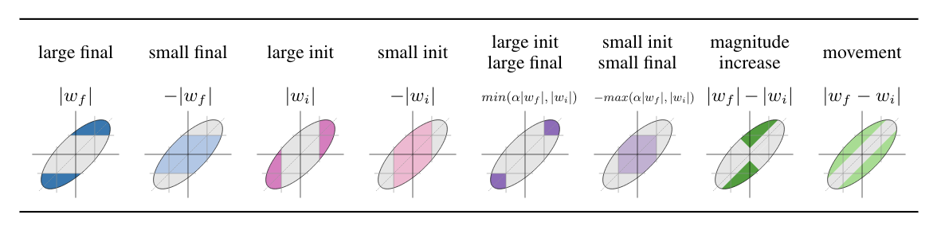
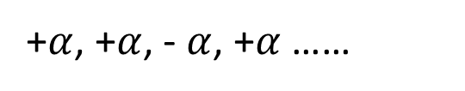
Why Pruning?
Deconstructing Lottery Tickets: Zeros, Signs, and the Supermask
https://arxiv.org/abs/1905.01067
Lottery Ticket Hypothesis
Different pruning strategy
“sign-ificance” of initial weights: Keeping the sign is critical
0.9, 3.1, -9.1, 8.5 ……
+$α$, +$α$, - $α$, +$α$ ……
Pruning weights from a network with random weights
Weight Agnostic Neural Networks
https://arxiv.org/abs/1906.04358

Slide 14
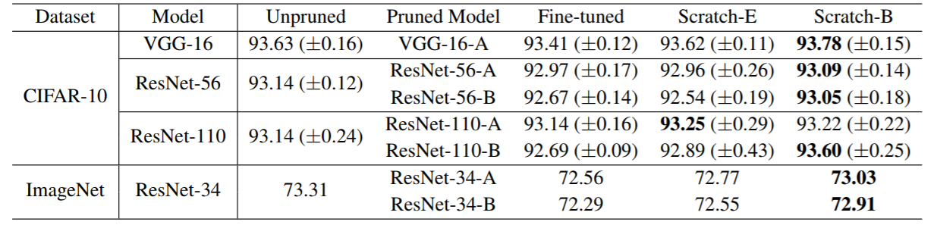
Why Pruning?
https://arxiv.org/abs/1810.05270
Rethinking the Value of Network Pruning
New random initialization, not original random initialization in “Lottery Ticket Hypothesis”
Limitation of “Lottery Ticket Hypothesis” (small lr, unstructured)
Notes:
Pruning algorithms could be seen as performing network architecture search

Slide 15
Knowledge Distillation
Notes:
https://github.com/dkozlov/awesome-knowledge-distillation

Slide 16

Knowledge Distillation
Knowledge Distillation
https://arxiv.org/pdf/1503.02531.pdf
Do Deep Nets Really Need to be Deep?
https://arxiv.org/pdf/1312.6184.pdf
Cross-entropy minimization
Learning target
“1”: 0.7, “7”: 0.2. “9”: 0.1
?
Teacher Net
(Large)
Student Net
(Small)
Providing the information that “1” is similar to “7”

Slide 17
Knowledge Distillation
Knowledge Distillation
https://arxiv.org/pdf/1503.02531.pdf
Do Deep Nets Really Need to be Deep?
https://arxiv.org/pdf/1312.6184.pdf
Cross-entropy minimization
Learning target
Ensemble
“1”: 0.7, “7”: 0.2. “9”: 0.1
?
Average many models
Model 1
Student Net
(Small)
Model 2
N Networks

Slide 18















Knowledge Distillation
Temperature for softmax
$$y_{i}^{′}=\frac{exp\left(y_{i}\right)}{\sum_{j}{exp\left(y_{j}\right)}}$$
$$y_{i}^{′}=\frac{exp\left(y_{i}/T\right)}{\sum_{j}{exp\left(y_{j}/T\right)}}$$
$$T=100$$
$$y_{1}=100$$
$$y_{1}^{′}=1$$
$$y_{1}/T=1$$
$$y_{1}^{′}=0.56$$
$$y_{2}=10$$
$$y_{2}^{′}≈0$$
$$y_{2}/T=0.1$$
$$y_{2}^{′}=0.23$$
$$y_{3}=1$$
$$y_{3}^{′}≈0$$
$$y_{3}/T=0.01$$
$$y_{3}^{′}=0.21$$
Notes:
At least mentioned temperature …

Slide 19
Parameter Quantization
Notes:
BinaryConnect: Training Deep Neural Networks with binary weights during propagations
Binarized neural networks: Training deep neural networks with weights and activations constrained to+ 1 or-1
Xnor-net: Imagenet classification using binary convolutional neural networks
Binary network:
All for quantizaion: https://www.ntnu.edu/documents/139931/1275097249/eecs-jun17-finn.pdf/38a98880-d663-4114-a045-97c80d79ce19
BinaryConnect: Training Deep Neural Networks with binary weights during propagations
Slide: http://web.eng.tau.ac.il/deep_learn/wp-content/uploads/2017/03/Binary-Deep-Learning.pdf
Binarized neural networks
Binarized neural networks: Training deep neural networks with weights and activations constrained to+ 1 or-1
Xnor-net: Imagenet classification using binary convolutional neural networks
Slides: http://www.cs.virginia.edu/~vicente/recognition/2016/presentations/xnornet.pdf
All for quantizaion: https://www.ntnu.edu/documents/139931/1275097249/eecs-jun17-finn.pdf/38a98880-d663-4114-a045-97c80d79ce19
http://www.cs.virginia.edu/~vicente/recognition/2016/presentations/xnornet.pdf

Slide 20
Parameter Quantization
1. Using less bits to represent a value
2. Weight clustering
0.5 | 1.3 | 4.3 | -0.1
0.1 | -0.2 | -1.2 | 0.3
1.0 | 3.0 | -0.4 | 0.1
-0.5 | -0.1 | -3.4 | -5.0
weights in a network
Clustering

Slide 21
Parameter Quantization
1. Using less bits to represent a value
2. Weight clustering
3. Represent frequent clusters by less bits, represent rare clusters by more bits
e.g. Huffman encoding
Table
0.5 | 1.3 | 4.3 | -0.1
0.1 | -0.2 | -1.2 | 0.3
1.0 | 3.0 | -0.4 | 0.1
-0.5 | -0.1 | -3.4 | -5.0
 | -0.4
 | 0.4
 | 2.9
 | -4.2
weights in a network
Clustering
Only needs 2 bits
Notes:
極致就是 binary

Slide 22
Binary Weights
Binary Connect: https://arxiv.org/abs/1511.00363
Binary Network:
https://arxiv.org/abs/1602.02830
XNOR-net:
https://arxiv.org/abs/1603.05279
Your weights are always +1 or -1
Binary Connect
network with binary weights
Negative gradient
network with real value weights
(compute on binary weights)
Update direction
(compute on real weights)
Notes:
Binary Connect

Slide 23
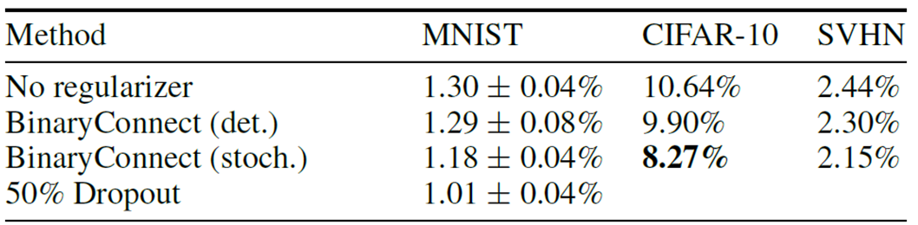
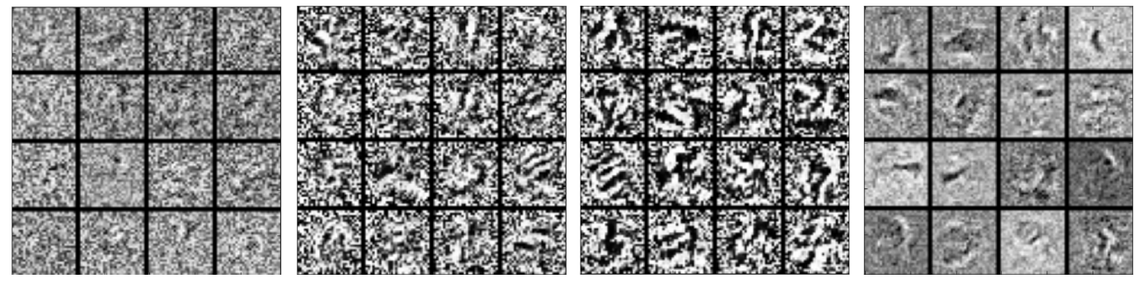
Binary Connect
https://arxiv.org/abs/1511.00363
Notes:
Lower: first layer of MLP on MNIST

Slide 24
Architecture Design
Depthwise Separable Convolution
Notes:
Deep Compression: Compressing Deep Neural Networks with Pruning, Trained Quantization and Huffman coding
Easy to read!
https://www.youtube.com/watch?v=vouEMwDNopQ
https://www.youtube.com/watch?v=CrDRr2fxbsg
https://www.zybuluo.com/w460461339/note/1257046

Slide 25
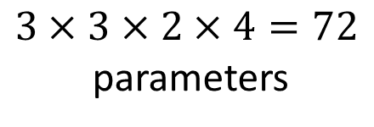
Review: Standard CNN
$$3×3×2×4=72$$
parameters
Input feature map
2 channels

Slide 26

Depthwise Separable Convolution
1. Depthwise Convolution
Filter number = Input channel number
Each filter only considers one channel.
The filters are $k×k$ matrices
There is no interaction between channels.

Slide 27

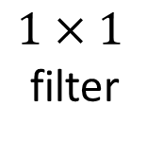

Depthwise Separable Convolution
1. Depthwise Convolution
$$3×3×2=18$$
2. Pointwise Convolution
$1×1$
filter
$$2×4=8$$

Slide 28






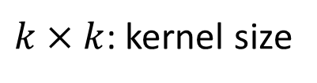

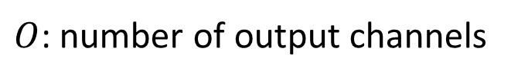


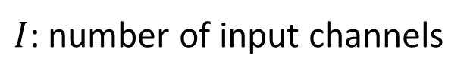


$I$: number of input channels
$$k×k×I$$
$O$: number of output channels
$$k×k×I$$
$k×k$: kernel size
$$k×k×I$$
$$k×k×I+I×O$$
$$k×k×I$$
$$k×k×I×O$$
$$I×O$$
$$=\frac{1}{O}+\frac{1}{k×k}$$
$$k×k×I$$
$$k×k×I+I×O$$
$$(k×k×I)×O$$

Slide 29
Low rank approximation
M
M
U
W
linear
K
V
N
N
N
K
N
W
U
V
K
M
≈
M
K < M,N
Less parameters

Slide 30
18 inputs
18 inputs
9 inputs
9 inputs

Slide 31
To learn more ……
SqueezeNet
https://arxiv.org/abs/1602.07360
MobileNet
https://arxiv.org/abs/1704.04861
ShuffleNet
https://arxiv.org/abs/1707.01083
Xception
https://arxiv.org/abs/1610.02357

Slide 32
Dynamic Computation
Notes:
Adaptive Neural Networks for Efficient Inference
Tolga Bolukbasi, Joseph Wang, Ofer Dekel, Venkatesh Saligrama, “Adaptive Neural Networks for Efficient Inference”arXiv:1702.07811
https://vimeo.com/238242188
Different layers? ???
Multi-scale dense network: http://blog.csdn.net/u014380165/article/details/78006893
https://www.jqr.com/article/000196
在中間就輸出

Slide 33
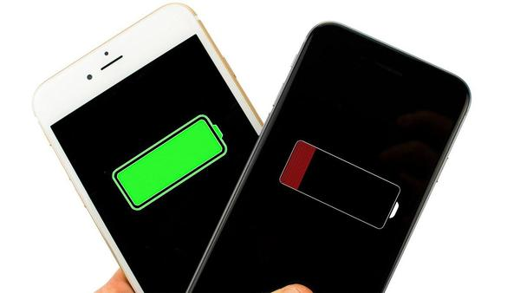

Dynamic Computation
Can network adjust the computation power it need?
資源充足，那麼就做到最好
減少運算量，先求有再求好 (但也不要太差)
Notes:
A big offline table needs to be maintained
to document the allocation of different models to different devices, according to time and energy
budget. Second, even on a same device, the computational budget varies (for example, excessive
consumption of background apps reduces the available computing capacity), and the energy budget
varies (for example, a mobile phone may be in low-power or power-saving mode).

Slide 34
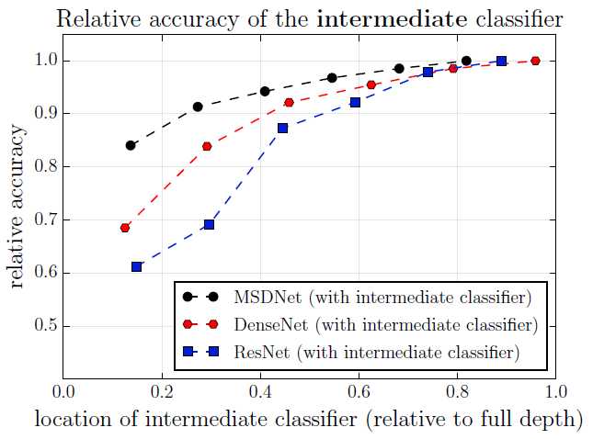
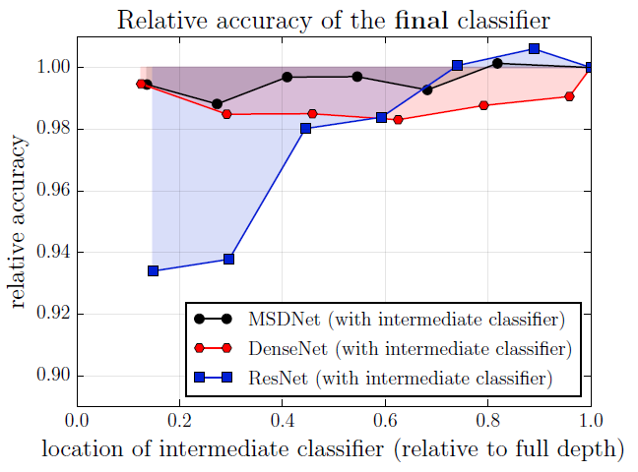
Possible Solutions
Layer
1
Layer
2
input
Classifier
Classifier
1. Train multiple classifiers
2. Classifiers at the intermedia layer
result
result
https://arxiv.org/abs/1703.09844

Slide 35
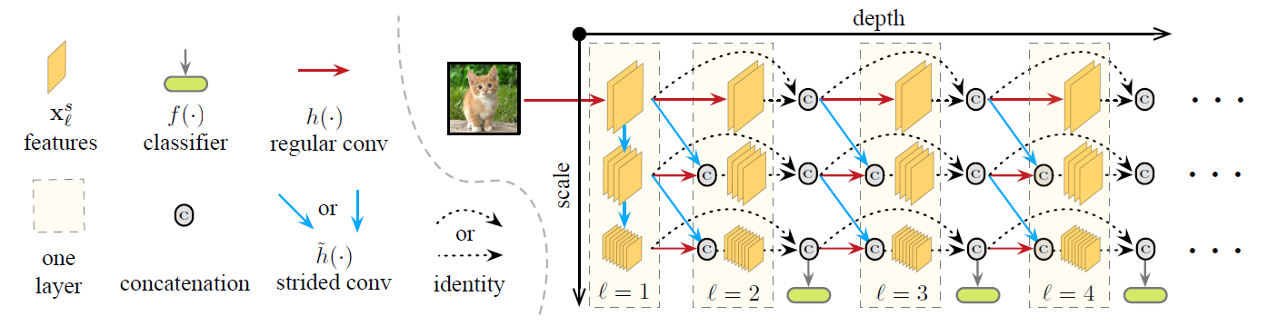
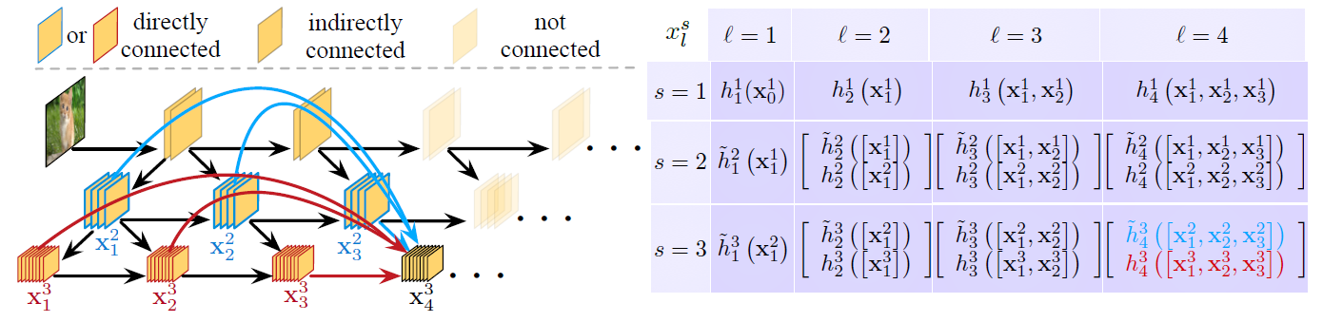
Multi-Scale Dense Networks
https://arxiv.org/abs/1703.09844

Slide 36
Concluding Remarks
Network Pruning
Knowledge Distillation
Parameter Quantization
Architecture Design
Dynamic Computation

